Slide 1

POSCAT Seminar 10 : Graph 3
yougatup @ POSCAT

Slide 2
Topic
Topic today
Minimum Spanning Tree
Cut Property
Prim Algorithm
Kruskal Algorithm

Slide 3
Spanning Tree
Definition
A tree which “spans” whole vertices
i.e. a tree with n vertices
1
3
2
2
4
3
5
1
1
1
2
3
6
9
7
3
8

Slide 4
Spanning Tree
Definition
A tree which “spans” whole vertices
i.e. a tree with n vertices
1
3
2
2
4
3
5
1
1
1
2
3
6
9
7
3
8

Slide 5
Minimum Spanning Tree
Problem
Find a spanning tree with minimum cost
1
3
2
2
4
3
5
1
1
1
2
3
6
9
7
3
8

Slide 6
Minimum Spanning Tree
Problem
Find a spanning tree with minimum cost
1
3
2
2
4
3
5
1
1
1
2
3
6
9
7
3
Is it MST ?
8

Slide 7
Minimum Spanning Tree
Problem
Find a spanning tree with minimum cost
1
3
2
2
4
3
5
1
1
1
2
3
6
9
7
3
Is it MST ?
8

Slide 8
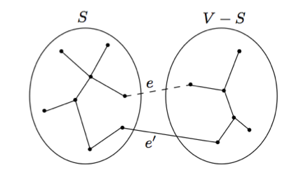

Cut Property
Theorem
Suppose edge X are part of a MST of $G=(V, E)$. Pick any subset of nodes S for which X does not cross between S and $V\backslash S,$ and let $e$ be the lightest edge across this partition. Then $X∪\{e\}$ is part of some MST
Proof ?

Slide 9

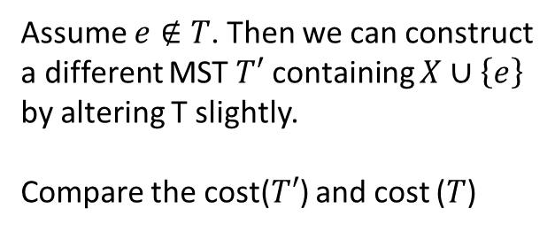
Cut Property
Theorem
Suppose X is a set of edges which are part of a MST of $G=(V, E)$. Pick any subset of nodes S for which X does not cross between S and $V\backslash S,$ and let $e$ be the lightest edge across this partition. Then $X∪\{e\}$ is part of some MST
Assume $e∉T$. Then we can construct a different MST $T′$ containing $X∪\left\{e\right\}$
by altering T slightly.
Compare the cost($T′$) and cost ($T$)

Slide 10
Cut Property
Theorem
Suppose X is a set of edges which are part of a MST of $G=(V, E)$. Pick any subset of nodes S for which X does not cross between S and $V\backslash S,$ and let $e$ be the lightest edge across this partition. Then $X∪\{e\}$ is part of some MST
by cut property, we can derive beautiful greedy algorithm !

Slide 11
Kruskal Algorithm
Approach
For each iteration, choose minimum edge which doesn’t make a cycle. Then it will make a MST by cut property.
1
3
2
2
4
3
5
1
1
1
2
3
6
9
7
3
8

Slide 12
Kruskal Algorithm
Approach
For each iteration, choose minimum edge which doesn’t make a cycle. Then it will make a MST by cut property.
1
3
2
2
4
3
5
1
1
1
2
3
6
9
7
3
8

Slide 13
Kruskal Algorithm
Approach
For each iteration, choose minimum edge which doesn’t make a cycle. Then it will make a MST by cut property.
1
3
2
2
4
3
5
1
1
1
2
3
6
9
7
3
8

Slide 14
Kruskal Algorithm
Approach
For each iteration, choose minimum edge which doesn’t make a cycle. Then it will make a MST by cut property.
1
3
2
2
4
3
5
1
1
1
2
3
6
9
7
3
8

Slide 15
Kruskal Algorithm
Approach
For each iteration, choose minimum edge which doesn’t make a cycle. Then it will make a MST by cut property.
1
3
2
2
4
3
5
1
1
1
2
3
6
9
7
3
8

Slide 16
Kruskal Algorithm
Approach
For each iteration, choose minimum edge which doesn’t make a cycle. Then it will make a MST by cut property.
1
3
2
2
4
3
5
1
1
1
2
3
6
9
7
3
8

Slide 17
Kruskal Algorithm
Approach
For each iteration, choose minimum edge which doesn’t make a cycle. Then it will make a MST by cut property.
?
1
3
2
2
4
3
5
1
1
1
2
3
6
9
7
3
8

Slide 18
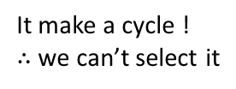
Kruskal Algorithm
Approach
For each iteration, choose minimum edge which doesn’t make a cycle. Then it will make a MST by cut property.
?
1
3
2
2
4
3
5
1
1
1
2
3
6
9
7
3
It make a cycle !
$∴$ we can’t select it
8

Slide 19
Kruskal Algorithm
Approach
For each iteration, choose minimum edge which doesn’t make a cycle. Then it will make a MST by cut property.
1
3
2
2
4
3
5
1
1
1
2
3
6
9
7
3
8

Slide 20
Kruskal Algorithm
Approach
For each iteration, choose minimum edge which doesn’t make a cycle. Then it will make a MST by cut property.
1
3
2
2
4
3
5
1
1
1
2
3
6
9
7
3
8

Slide 21
Kruskal Algorithm
Approach
For each iteration, choose minimum edge which doesn’t make a cycle. Then it will make a MST by cut property.
1
3
2
2
4
3
5
1
1
1
2
3
6
9
7
3
8

Slide 22
Kruskal Algorithm
Approach
For each iteration, choose minimum edge which doesn’t make a cycle. Then it will make a MST by cut property.
1
3
2
2
4
3
5
1
1
1
2
3
6
9
7
3
8

Slide 23
Kruskal Algorithm
Approach
For each iteration, choose minimum edge which doesn’t make a cycle. Then it will make a MST by cut property.
1
3
2
2
4
3
5
1
1
1
2
3
6
9
7
3
8
Done ! we have no remaining edges

Slide 24
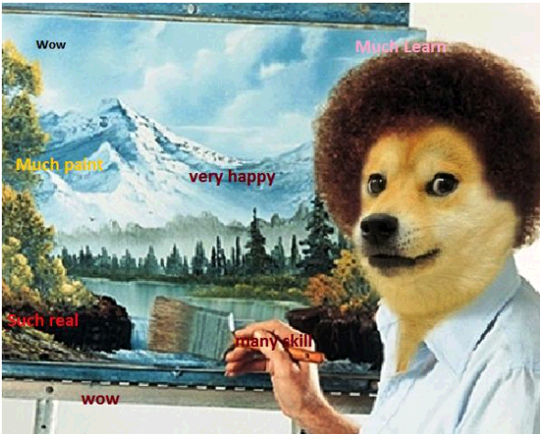
Kruskal Algorithm
Approach
For each iteration, choose minimum edge which doesn’t make a cycle. Then it will make a MST by cut property.
1
3
2
2
4
3
5
1
1
1
2
3
6
9
7
3
8
Done ! we have no remaining edges

Slide 25
Kruskal Algorithm
Question
How can we determine whether adding a edge makes a cycle or not ?
1
3
2
2
4
3
5
1
1
1
2
3
6
9
7
3
8

Slide 26
Kruskal Algorithm
Question
How can we determine whether adding a edge makes a cycle or not ? → by using Disjoint Set !
1
3
2
2
4
3
5
1
1
1
2
3
6
9
7
3
8

Slide 27
Kruskal Algorithm
Question
How can we determine whether adding a edge makes a cycle or not ? → by using Disjoint Set !
If a edge connects two vertices with different group, it will never make a cycle.
1
3
2
2
4
3
5
1
1
1
2
3
6
9
7
3
8

Slide 28
Kruskal Algorithm
Question
How can we determine whether adding a edge makes a cycle or not ? → by using Disjoint Set !
If not, it will make a cycle !
1
3
2
2
4
3
5
1
1
1
2
3
6
9
7
3
8

Slide 29
Kruskal Algorithm
Question
How can we determine whether adding a edge makes a cycle or not ? → by using Disjoint Set !
1
2
3
4
1
3
2
2
4
3
5
1
1
1
2
5
6
7
8
3
6
9
7
3
8

Slide 30
Kruskal Algorithm
Question
How can we determine whether adding a edge makes a cycle or not ? → by using Disjoint Set !
1
2
3
4
1
3
2
2
4
3
5
1
1
1
2
5
6
7
8
3
6
9
7
3
8

Slide 31
Kruskal Algorithm
Question
How can we determine whether adding a edge makes a cycle or not ? → by using Disjoint Set !
1
3
2
4
1
3
2
2
4
3
5
1
1
1
2
5
6
7
8
3
6
9
7
3
8

Slide 32
Kruskal Algorithm
Question
How can we determine whether adding a edge makes a cycle or not ? → by using Disjoint Set !
1
3
2
4
1
3
2
2
4
3
5
1
1
1
2
5
6
7
8
3
6
9
7
3
8

Slide 33
Kruskal Algorithm
Question
How can we determine whether adding a edge makes a cycle or not ? → by using Disjoint Set !
2
1
3
4
1
3
2
2
4
3
5
1
1
1
2
5
6
7
8
3
6
9
7
3
8

Slide 34
Kruskal Algorithm
Question
How can we determine whether adding a edge makes a cycle or not ? → by using Disjoint Set !
2
1
3
4
1
3
2
2
4
3
5
1
1
1
2
5
6
7
8
3
6
9
7
3
8

Slide 35
Kruskal Algorithm
Question
How can we determine whether adding a edge makes a cycle or not ? → by using Disjoint Set !
2
1
3
6
4
1
3
2
2
4
3
5
1
1
1
2
5
7
8
3
6
9
7
3
8

Slide 36
Kruskal Algorithm
Question
How can we determine whether adding a edge makes a cycle or not ? → by using Disjoint Set !
2
1
3
6
4
1
3
2
2
4
3
5
1
1
1
2
5
7
8
3
6
9
7
3
8

Slide 37
Kruskal Algorithm
Question
How can we determine whether adding a edge makes a cycle or not ? → by using Disjoint Set !
2
4
1
3
6
1
3
2
2
4
3
5
1
1
1
2
5
7
8
3
6
9
7
3
8

Slide 38
Kruskal Algorithm
Question
How can we determine whether adding a edge makes a cycle or not ? → by using Disjoint Set !
2
4
1
3
6
1
3
2
2
4
3
5
1
1
1
2
5
7
8
3
6
9
7
3
8

Slide 39
Kruskal Algorithm
Question
How can we determine whether adding a edge makes a cycle or not ? → by using Disjoint Set !
2
4
1
3
6
1
3
2
2
4
3
5
1
1
1
2
5
7
8
3
6
9
7
3
8

Slide 40
Kruskal Algorithm
Question
How can we determine whether adding a edge makes a cycle or not ? → by using Disjoint Set !
No !!
2
4
1
3
6
1
3
2
2
4
3
5
1
1
1
2
5
7
8
3
6
9
7
3
8

Slide 41
Kruskal Algorithm
Question
How can we determine whether adding a edge makes a cycle or not ? → by using Disjoint Set !
2
4
1
3
6
1
3
2
2
4
3
5
1
1
1
2
5
7
8
3
6
9
7
3
8

Slide 42
Kruskal Algorithm
Question
How can we determine whether adding a edge makes a cycle or not ? → by using Disjoint Set !
2
4
5
1
3
6
7
1
3
2
2
4
3
5
1
1
1
2
8
3
6
9
7
3
8

Slide 43
Kruskal Algorithm
Question
How can we determine whether adding a edge makes a cycle or not ? → by using Disjoint Set !
2
4
5
1
3
6
7
1
3
2
2
4
3
5
1
1
1
2
8
3
6
9
7
3
8

Slide 44
Kruskal Algorithm
Question
How can we determine whether adding a edge makes a cycle or not ? → by using Disjoint Set !
2
4
5
8
1
3
6
7
1
3
2
2
4
3
5
1
1
1
2
3
6
9
7
3
8

Slide 45
Kruskal Algorithm
Question
How can we determine whether adding a edge makes a cycle or not ? → by using Disjoint Set !
2
4
5
8
1
3
6
7
1
3
2
2
4
3
5
1
1
1
2
3
6
9
7
3
8

Slide 46
Kruskal Algorithm
Question
How can we determine whether adding a edge makes a cycle or not ? → by using Disjoint Set !
2
4
5
8
1
3
6
7
1
3
2
2
4
3
5
1
1
1
2
3
6
9
7
3
8

Slide 47
Kruskal Algorithm
Implementation
We have to sort the set of edges via their costs → with STL
Union & Find
→ Quite simple !

Slide 48
Kruskal Algorithm
Implementation
We have to sort the set of edges via their costs → with STL
Union & Find
Quite simple !
Analysis ?

Slide 49
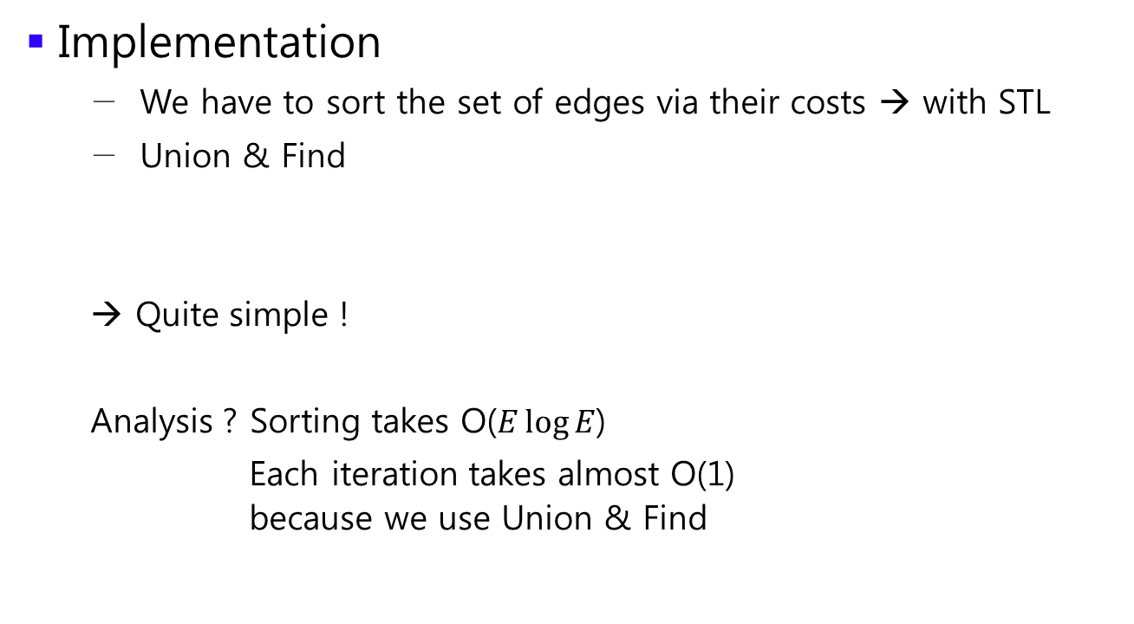
Kruskal Algorithm
Implementation
We have to sort the set of edges via their costs → with STL
Union & Find
Quite simple !
Analysis ? Sorting takes O($E\log{E}$)
Each iteration takes almost O(1) because we use Union & Find

Slide 50
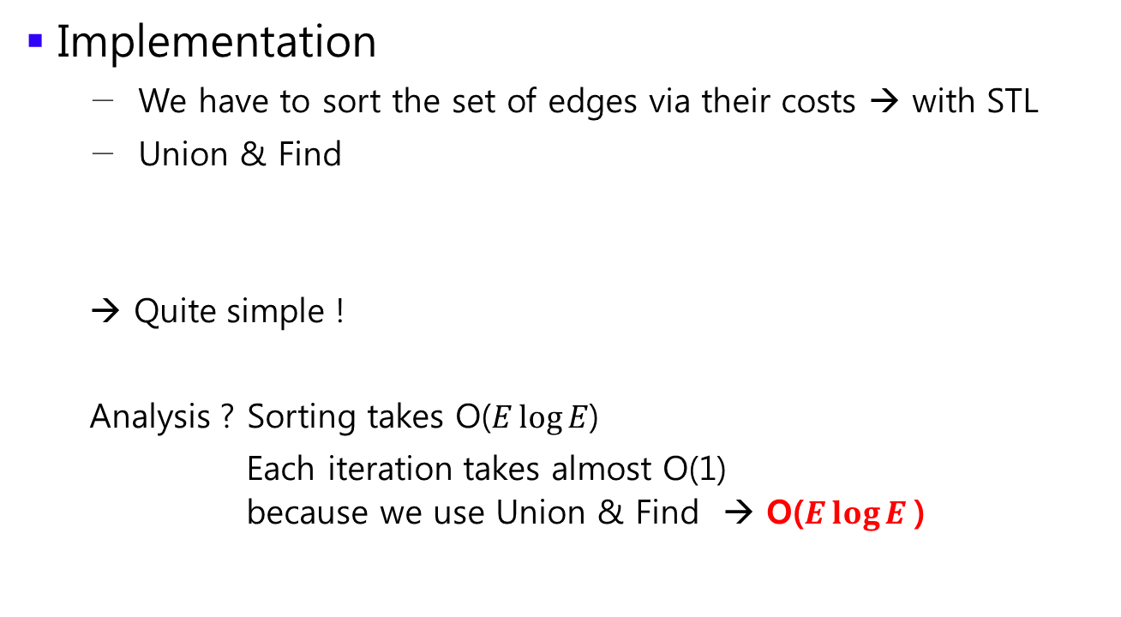
Kruskal Algorithm
Implementation
We have to sort the set of edges via their costs → with STL
Union & Find
Quite simple !
Analysis ? Sorting takes O($E\log{E}$)
Each iteration takes almost O(1) because we use Union & Find → O($E\log{E }$)

